Slide 1
Foundation Literacy and Maths Meeting
January 2017

Slide 2
Thank you
Firstly thank you for attending
Secondly you are already doing a great job, as all the children enjoy listening to stories
Please continue to do this as this gives children the enjoyment of books and helps them to become and want to be readers

Slide 3
To support children at home we ask parents to:
Give quality time
To continue to share/read picture books
Use different voices when reading stories
Let your children pretend to read
Ask them to retell stories [main points]
Show them where the text is, and that this is what tells the story
Follow along with finger
Ask questions about the story
Ask why questions
Ask what might happen next [prediction]

Slide 4
Reading Books
Your child will bring home a phonically decodable book
Some children will have a ‘Sounds and Letters’ book
Some children will have a phonically decodable book where most words can be blended
All of the reading books have specific guidance for you to use inside the front and back covers
We will change the reading books every Monday and Thursday

Slide 5
Reading Diaries
Children will be at different stages of reading
Please look at the guidance inside the cover to see how to support your child with their reading
The purpose of the diary is two fold. It is there for you to comment on their reading. Be positive, but please ask questions if you are unsure.
Some parents put stickers etc in the diary
You can also use it to give us a message that is not about their reading
The TA’s read the comments when they change
the reading books and tick to acknowledge they have read the comments
Your child’s class teacher will regularly listen to your child read in class. Please ensure your child brings their reading book into school each day even if they have not yet completed the book.

Slide 6
Hearing your child read
Let your child have a go
Parent to help when the child becomes stuck, always interrupt when struggling
The most important strategy to use when reading is the phonic approach, by decoding
But remember that not all words are decodable so sometimes they will have to learn these and keep them in their sight vocabulary, also known as tricky words or HFW [high frequency words]

Slide 7
Decoding/Blending for reading
This is where a child will say each letter by its sound and blend them all together to say the whole word
sit becomes…
s
i
t

Slide 8
All the reading strategies
Phonics as I have mentioned, is the first priority
Visual memory [known as tricky words or high frequency words]
Picture cues
Guessing and predicting
Contextual clues

Slide 9
100 High frequency words
See sheet
They are either phonically decodable
Or known as tricky words
These are taught through the phases and are taught alongside many other decodable words using the letters that have been introduced gradually

Slide 10
Phonics homework
Speed Sounds [phonemes, the unit of sound that either an individual letter makes or a group of letters]
Words for blending to read
Phoneme frame
Letters to use with the phoneme frame
Extension – Write the word
Please keep the folders at home with you. We do not need the sheets back into school, they are for your child to continue to revise the sounds at home
A new sheet will be sent home every Monday

Slide 11
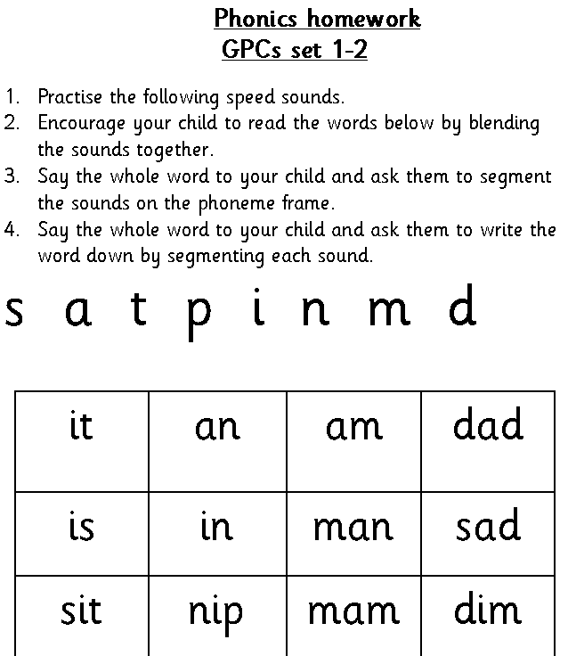

Slide 12
Reading Bug
https://www.activelearnprimary.co.uk

Slide 13
https://www.activelearnprimary.co.uk

Slide 14
Numbers Shape, Space and Measures

Slide 15
Maths is Everywhere

Slide 16
Thank you

Slide 17
And finally
Hopefully the meeting has been of some use to you
Thank you for listening
Any questions
Please don’t hesitate to ask your child’s class teacher/s if you are unsure of anything, or drop us a line in the reading diary

