Slide 1
National Curriculum Assessments 2020 (SATs)

Slide 2
What are the National Curriculum Assessments? (SATs)
Who takes the tests? Where and when they are taken? How they are different to 3 years ago?
Ways to support the children.

Slide 3
National Curriculum Assessments
The new national curriculum will be assessed for the third time in May 2018. There will be tests for key stage 1, as well as key stage 2.
The tests will cover English reading, English grammar, punctuation and spelling, and mathematics.

Slide 4
Purpose of the National Curriculum Assessments
To provide information which national bodies compile and use to compare the performance of schools.

Slide 5
Who Takes The National Curriculum Assessments?
The majority of children in England, Wales and Northern Ireland who are in Year 6.
Approximately half a million children throughout the country will take exactly the same tests on exactly the same days.

Slide 6
English
There are 2 externally marked English tasks:
reading comprehension
grammar, spelling and punctuation
Reading
The children have an hour to answer a reading comprehension paper.
GAPS (grammar, punctuation and spelling)
New assessment in 2013. The children have 45 minutes to answer 45 questions. These are a mixture of short answer and multiple choice.

Slide 7
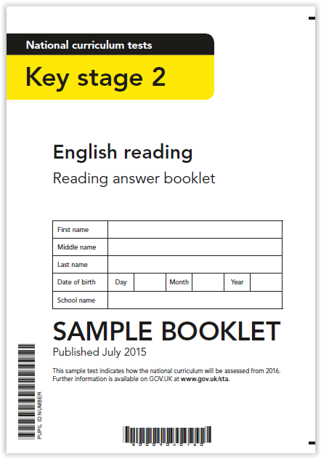
Reading Comprehension
Reading (Externally marked)
The children have an hour to answer a reading comprehension paper.

Slide 8
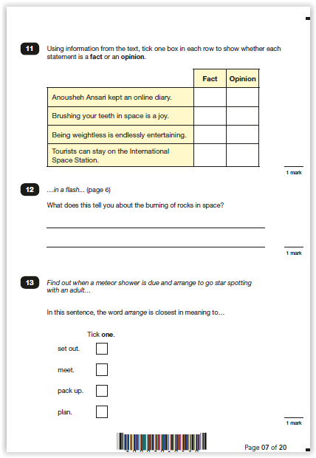
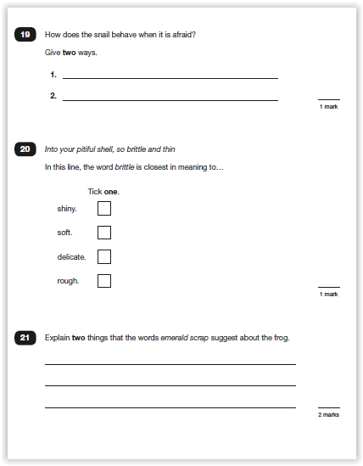
Reading Comprehension
Reading
Approximately 35 questions to answer. The three reading papers become progressively more difficult.

Slide 9
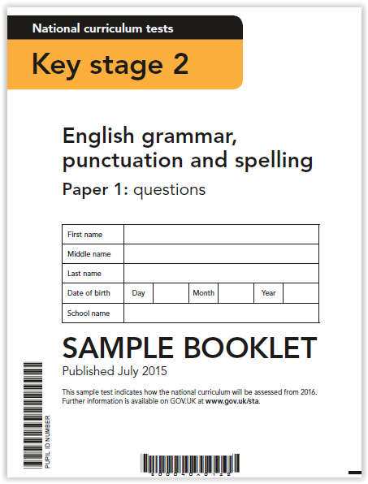
Grammar, punctuation and spelling
Grammar and punctuation paper.
Spelling test.

Slide 10
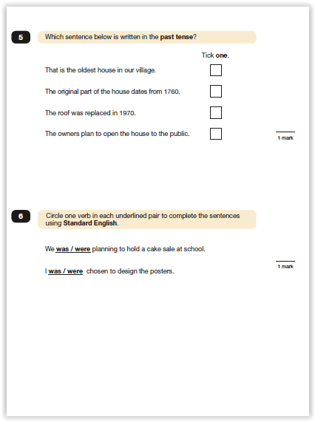
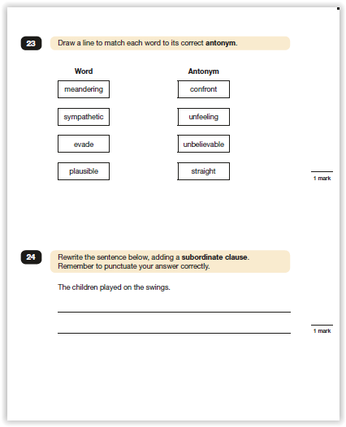
Grammar, punctuation and spelling

Slide 11
Writing
A range of writing is assessed by class teachers
Writing moderated in school
Cross moderation with other schools in the MAT
External moderation by the Local Authority

Slide 12
Mathematics
There are 3 externally marked Maths papers:
arithmetic
2x mathematical reasoning
Arithmetic
The children have 30 minutes to answer 36 arithmetic questions
Mathematical Reasoning
A more challenging version of the old SATs papers.

Slide 13
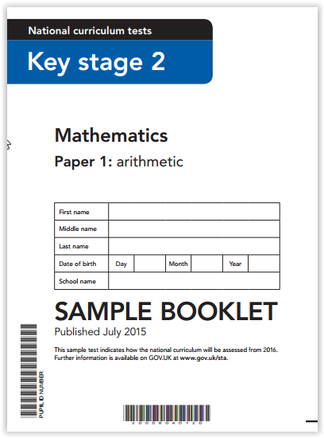
Arithmetic

Slide 14
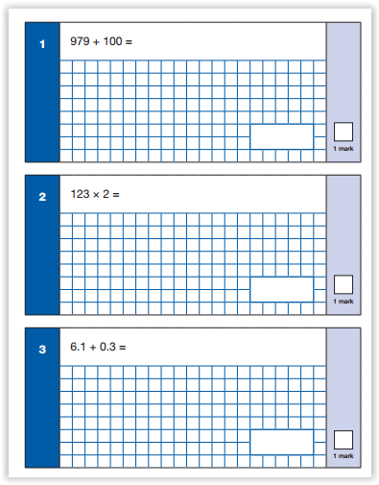
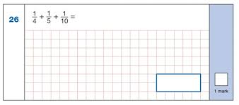
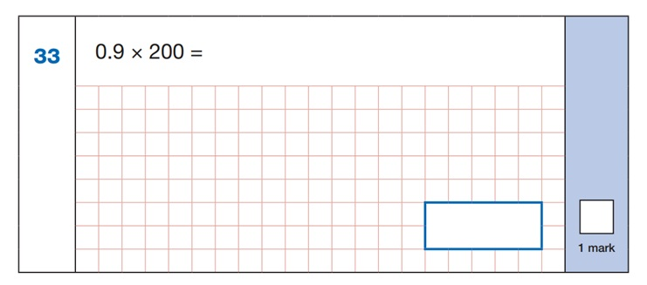
Arithmetic

Slide 15
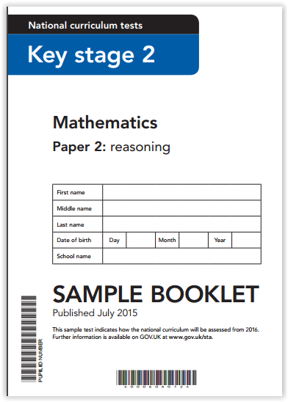
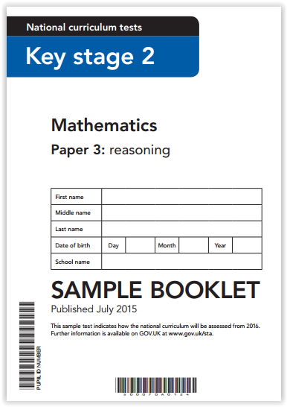
Reasoning

Slide 16
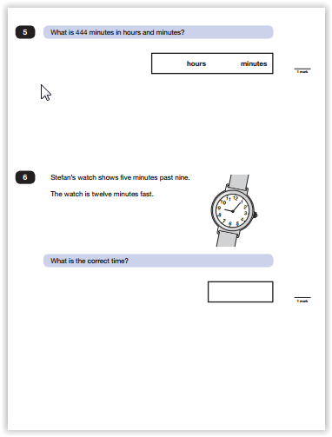
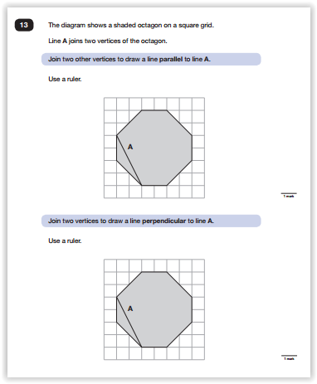
Reasoning
A more challenging version of the old SATs test

Slide 17
Who marks the tests?
The tests are sent by secure delivery to independent markers organised by the STA.
The school will receive a scaled score and whether each child has reached the expected standard.
We will communicate this to parents.

Slide 18
How can we help the children?
Coaching
Encouraging the children to try their best
Supporting homework
Being on time for school
Having enough sleep
Eating breakfast

