Slide 1
Assessment and Reporting Without Levels February 2016
Inspiring today’s children for tomorrow’s world

Slide 3
Early Learning Goals
Every child is being observed daily. These observations will support the end of year assessments
Emerging – The children have met some but not yet all of the ELG objectives
Expected – The children have achieved all of the ELG objectives
Exceeding – The children have achieved all of the ELG and met some of the Y1 expectations for attainment

Slide 4
CONTEXT Year 1-6 children
We did have levels from 1 through to 6 in primary schools. Y2 expected to achieve L2 (most able L3)
Y6 expected to achieve L4 (most able L5 and some L6)
New National Curriculum 2014 was introduced by the government 18 months ago and starts with children in year 1.Children in Foundation are taught from the Learning and Development Requirements for Early Years.
The National Curriculum is based on age related expectations (ARE) for each year group.
Data is lower profile in everyday work and ‘assessment information’ is used to see what children need to learn next and if they have any gaps in their learning.
All children are expected to achieve the ARE.
Children who have grasped the content will be challenged with deeper thinking activities to develop further cognitive understanding and reasoning. (This is often referred to as mastery or working at greater depth.)
The underlying principal being that all children are ‘secondary ready’ by the end of primary school.

Slide 5
MASTERY AND GREATER DEPTH IN ASSESSMENT – A CLARIFICATION
The new national curriculum is premised on the following explanation of mastery linked to the theory originally presented by Benjamin Bloom in the 1960s
Learning is broken down into discrete units and presented in a logical order
We aim for pupils to demonstrate mastery of the learning from each unit before being allowed to move onto the next
Our expectation is that all pupils can achieve mastery if they are appropriately supported: some may take longer and need more help, but will get there in the end
Teachers deliver high quality instruction followed by formative assessment that shows what each individual pupil has learnt and what they still need to work on
This approach will allow for specific ‘corrective’ activities to be designed that will help pupils to master the topic, subject concept or content
Those that have achieved mastery will undertake alternative enrichment or extension activities
All pupils should have access to the whole curriculum and it is pupil support and the depth of learning which teachers should differentiate, not the content
This new approach has had a greater effect on Maths than other subjects so here are some examples.

Slide 6
Year 1 example
Year 2 example

Slide 7
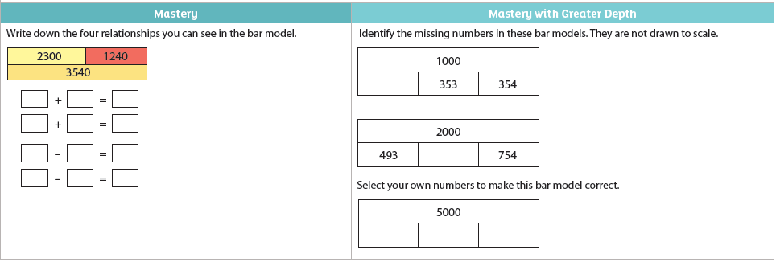
Year 3 example.
Year 4 example.

Slide 8
Year 5 example.
Year 6 example.

Slide 9
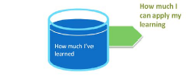
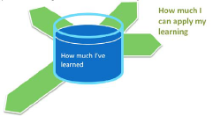
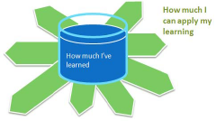
A visual guide to Mastery (From Pupil Tracker)
Previously, levels measured how much a child had learned ‐ how many objectives and whether they could get the questions correct when they were asked.
In the new National Curriculum and its testing and assessment arrangements, pupils are assessed on:
1.The objectives (parts of the National Curriculum) a child has achieved
2.The depth to which they can use and apply their knowledge of these objectives (Mastery)
A child who has achieved all of the objectives required of them will need to apply these. Children who cannot apply their learning may not reach the required Standard.
A child who has achieved all of the objectives required of them who also has the abilities to apply and connect this learning will be able to answer more of the difficult problems when assessed and so will demonstrate a higher ability.

Slide 10
The approach the school is taking.
How do we track and record this assessment?
Teachers plan activities based on the age appropriate
programmes of study or to fill gaps in a child’s learning or from
their IEP for children with very specific needs.
All children are expected to achieve this.
They build in challenge for children with tasks that
deepen thinking and apply the knowledge to new situations.
(to develop and assess mastery and greater depth)
This will be recorded on pupil tracker. Gaps can be identified
as well as a level of mastery.
Example of this.

Slide 11
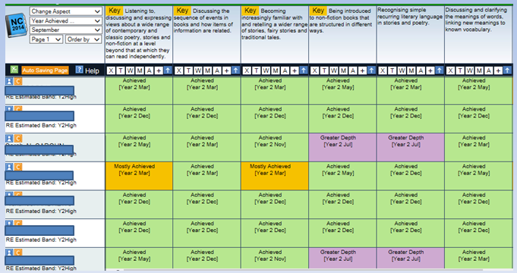
Pupil Tracker - recording learning and identifying gaps.

Slide 12
Progressively through the year children will move through. e.g Y2 low Y2 mid Y2 high
Depth and application of learning ‐ Overall Mastery Rating will also be tracked.
Note that a certain level of mastery is expected by all pupils.
#1/#1+ [Low]
#2/#2+ [Expected]
#3 /#3+[Good]
#4/#4+ [Very good]
This is below the expected standard depth of application and understanding.
Does not apply their learning.
This is the expected standard depth of application and understanding.
Average application of learning.
This is above the expected standard depth of application and understanding.
Good application of learning.
This is well above the expected standard depth of application and understanding.
Very good application of learning.
Recalls facts, remembers learnt information.
Constructs simple responses.
Applies understanding.
Uses facts, information or procedures to respond to, solve and answer problems.
Applies own knowledge in a different context.
Connects knowledge together to build up their learning.
Applies understanding in more complex situations.
Uses facts, information or procedures to respond to, solve and answer complex problems.
Connects learning together from a variety of objectives and independently extends learning into other subjects.
Applies own knowledge in an alternative and unusual context.
Applies understanding creatively in more intricate situations.
Uses facts, information or procedures to respond to, solve and answer complex and unfamiliar problems.
Independently connects learning together from a very wide variety of objectives and subjects.
Applies own knowledge into alternative and unique contexts.

Slide 13
EYFS REPORTS
The final report will inform parents of the achievement of their children based on the Development Matters statements. The Development Matters statements cover three prime and four specific areas of learning. Within the prime areas of learning there are: Communication and Language, Physical Development and Personal, Social and Emotional Development. Within the specific areas of learning there are: Literacy, Mathematics, Understanding of the World and Expressive Arts and Design. Following an initial baseline assessment, Teachers and Teaching Assistants completed regular ongoing observations and assessments to monitor the children's progress throughout the year. At Elburton Primary School we capture children's development by creating an electronic learning journal specific to each child. This learning journal has been shared with parents regularly throughout the year. Observations and assessments have fed into planning of lessons and activities to ensure the children have made progress and engaged with the Foundation Stage Curriculum.

Slide 14
Reporting to parents Y1,3,4,5 -The school system.
•A child working at ARE at the end of Year 1 who demonstrates a Mastery Rating of '3', would be Y1High #3
•A child working at the middle of Year 4 expectation who demonstrates a Mastery Rating of '1', would be Y4Mid #1
•A child working at the beginning of Year 3 expectation who demonstrates a Mastery Rating of '2', would be Y3Low #2
•A child working at ARE at the end of Year 5 expectation who demonstrates a Mastery Rating of '4', would be Y5High #4
Teacher Assessment this year for end of Key Stage 1 (year2) and end of Key Stage 2 (year 6) will be different and interim for this year only.

Slide 15
End of key stage Reporting and Assessment.
KS 1 (Year 2 children)
There will be tests for reading, grammar punctuation and spelling and maths. These will generate a scaled score of which 100 will represent ARE. They will be used to inform teacher assessment along with written, practical and oral classwork and homework.
Writing and science will just be based on teacher assessment.
Teacher Assessment will be based on 2015-16 Interim Teacher Assessment frameworks. These do not cover all aspects of learning but offer elements that typify a child working at ARE. They are broken down into :
Working towards expected standard,
Working at expected standard
Working at greater depth within the expected standard.
Science just has Working at expected standard
We intend to share the test scores with parents as well although we don’t have to and some other schools may not.

Slide 16
KS 2
There will be tests for reading, grammar punctuation and spelling and maths. These will generate a scaled score of which 100 will represent ARE.
There will also be Teacher Assessment as a separate piece of information.
Teacher Assessment will be based on 2015-16 Interim Teacher Assessment frameworks. These do not cover all aspects of learning but offer elements that typify a child working at ARE.
Reading , maths and science will be based on:
Working at expected standard.
Writing will be based on:
Working towards expected standard,
Working at expected standard
Working at greater depth within the expected standard.

Slide 17
Sharing your child’s work.
Look through the book to see progress across the year.
Look for Learning Intentions and success criteria to focus on the aspect of learning being taught.
Talk with your child about how they have improved and how they can improve further.
Look for work that encourages understanding as well as knowledge (the mastery and greater depth elements).

