Slide 1
Welcome to the ‘Getting To Know Year 4’ Meeting 2020
Inspiring today’s children for tomorrow’s world

Slide 2
The Year 4 Team
4SG – Mr Griggs
4SB - Mrs Bates
Teaching Assistants – Mrs Causon, Mrs Woodhams & Mrs Twaits
Teaching Assistant Apprentice – Mr Ryan
Inspiring today’s children for tomorrow’s world

Slide 3
Expectations and Daily Organisation
More emphasis on independence and responsibility (Personal organisation: pencil cases, home learning, behaviour etc.).
Importance of water bottles (named and refilled at home daily).
Break time snacks (healthy fruit/veg or similar).
PE kits: To be worn all day on their PE day (Wednesday).
During the summer term, we hope that the children will be able to swim; swimming kits will need to be in school on the appropriate day (more advice nearer the time).
Talking partners are changed regularly to ensure children experience a wide range of partners throughout the year.
Inspiring today’s children for tomorrow’s world

Slide 4
Mathematics
Maths objectives are based on ARE’s (Age Related Expectations)
We follow the White Rose Scheme for maths where the children learn through a series of small steps which build to consolidate their understanding. These lessons are grouped into blocks ranging in length from 1-5 weeks depending on content.
We have a ‘confident to be wrong’ approach to maths; it’s important for children to understand that they can learn from their mistakes.
The children also complete daily morning maths tasks focussing on fluency.
Times Tables Rock Stars is used in class and at home to develop quick recall of multiplication facts.
Inspiring today’s children for tomorrow’s world

Slide 5
The children use manipulatives and representations to help visualise numbers and mathematical problems.
Inspiring today’s children for tomorrow’s world

Slide 6
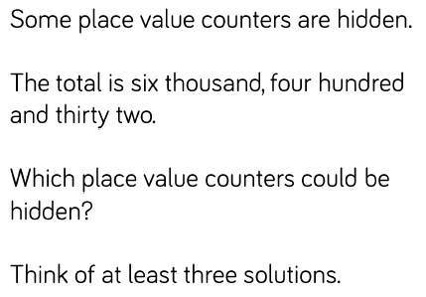
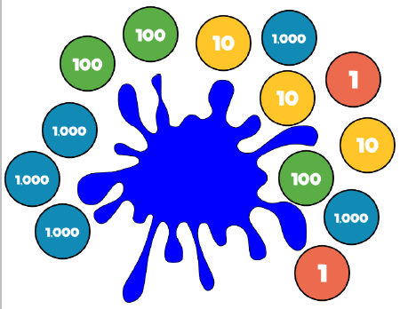
An example of independent learning in maths
Independent work:
Problem Solving:
1. Look at the representation. Record six different ways of partitioning this number.
2. Josh says, “My number has 4 thousands, 8 hundreds and 27 ones”. What is Josh’s number?
3. Sally says, “My number has 3 thousands, 12 hundreds and 6 ones”. What is Sally’s number?
Inspiring today’s children for tomorrow’s world

Slide 7
Writing
Through the year, we will cover a range of genres.
There will be a focus on pride in all written work throughout all subjects.
Children will be involved in both self and peer assessment to help them improve their writing.
Throughout the year children will have lots of opportunities to draft and edit longer pieces of writing.
This year it has been decided by the teaching team that in Year 4 all children will be writing in pencil.
Non-negotiables for writing will include capital letter, full stops and joined, cursive handwriting following the LetterJoin scheme.
Inspiring today’s children for tomorrow’s world

Slide 8
Reading
Children are expected to read at home with an adult for 10-15 minutes, five times a week.
We develop children’s reading in various ways including whole class reading, paired and independent reading.
A variety of different genres are chosen to ensure that the children are exposed to a range of vocabulary, styles and purposes.
We also have a class reader which is read throughout the week.
Book Talk will be introduced later in the term to encourage children to share books they have enjoyed and to develop a love of reading.
Inspiring today’s children for tomorrow’s world

Slide 9
Reading
There is a big emphasis on reading again this year in order to raise the profile of reading throughout the school. We have several initiatives to enhance the children’s love of reading and to enrich their vocabulary:
Word of the Day
ERIC – Explain, Retrieve,
Interpret & Choice.
Developing higher order
reading skills (Vocabulary,
Inference, Prediction, Explanation,
Retrieve and Summarise).
Class reader
Inspiring today’s children for tomorrow’s world

Slide 10
Speaking and Listening
In school we ask the children to:
Speak to different audiences (drama, role play, performance poetry, debate).
Use appropriate vocabulary for different audiences. Encourage them by modelling high level vocabulary.
The biggest difference you can make for your child is to:
Insist your child talks in full sentences.
Not use ‘Yeah’, ‘fine’ or ‘K’ (don’t let them overuse this).
Insist they show good listening habits such as stopping, looking you in the eye and repeat instructions.
Inspiring today’s children for tomorrow’s world

Slide 11
Home Learning
At the start of each half term, the children will be given a grid containing a broad range of tasks spanning a number of subject areas. The children will choose at least six home learning tasks to complete by the end of each half term.
Reading is of utmost importance and should be a priority for home learning. We expect the children to read aloud to an adult for 10-15 minutes at least 5 times a week in order to develop their fluency, give you the opportunity to explain the meaning of new words and to check their understanding through questioning. We strongly recommend that you read to them as much as possible, preferably from a book that they would not necessarily choose or be able to read themselves, to develop their understanding and overall enjoyment of reading. Reading to your child has a huge impact on their progress.
We will continue to introduce a new spelling rule every Monday in school and practise it throughout the week. These weekly spellings will be set on Spelling Shed for the children to practise at home (at least 3 times a week) and will be tested on the Friday.
Times Table Rock Stars will continue to be accessible at all times and MyMaths will be used where appropriate to support children’s learning; any tasks set will be linked to the children’s learning from that week.

Slide 12
E-Safety
This is an important issue for children and adults.
There are some documents to support E-Safety on our school website on the Year 4 class page.
If you should have any concerns or feel we should be notified about any inappropriate online content, please don’t hesitate to let us know.
Inspiring today’s children for tomorrow’s world

Slide 13
How to Help
Continue to listen to your child read regularly (at least 3 times per week) and record this in their reading record with a comment – we check these on a weekly basis.
Be involved in home learning (but don’t do it for them!).
Help your child learn their addition and multiplication facts.
Promote a positive attitude to learning - please don’t share negative school experiences. Ask them carefully crafted questions - not just how was your day? Promote positivity!
Insist on the basics in writing and in speech at all times (GHaSP – Grammar, Handwriting, Spelling and Punctuation).
Inspiring today’s children for tomorrow’s world

Slide 14
We hope that you have found this information useful.
We look forward to seeing you (virtually!) at the forthcoming parents’ evening.
Thank you for your continued support.
Inspiring today’s children for tomorrow’s world

