Slide 3
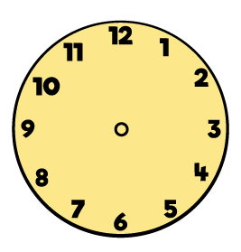
1) What time is it?
2) What time will it be in 1 hour?
3) Which clock shows 6 o’clock?
4) What hand is the longest?
hour or minute

Slide 4
1) What time is it?
2) What time will it be in 1 hour?
3) Which clock shows 6 o’clock?
4) What hand is the longest?
hour or minute
8 o’clock
9 o’clock

Slide 6
How much time does it take?
Minutes
Hours
Seconds

Slide 7
How long would it take?
Have a think
seconds
minutes
hours
To wash your hands?
minutes
To watch a film?
hours
To drink a glass of water?
seconds

Slide 8
How long would it take?
Have a think
seconds
minutes
hours
To brush your teeth?
minutes
To fill a bowl of cereal?
seconds
To take a plane ride?
hours

Slide 9
Have a go at question 1 on the worksheet

Slide 10
Have a think
What could you do in
4 seconds?
Build a castle
Write 1-5
Clap 10 times

Slide 11
Have a think
What could you do in
5 minutes?
Eat
Ride
Change

Slide 12
Have a think
What could you do in
2 hours?
School day
Play
Fly

Slide 13
Have a go at questions 2 and 3 on the worksheet

Slide 14
Teddy is having a birthday party!
Have a think
How long will…
It take to make the cake?
It take to blow out the candles?
It take to eat the cake?
hours
seconds
minutes

Slide 15
Have a think
How long will…
It take to decorate the house?
It take to wrap a present?
It take to unwrap a present?
The party last?
hours
minutes
seconds
hours

Slide 16
Have a go at question 4 on the worksheet

