Slide 1
Forest School

Slide 2
What is Forest School?
Forest school is underpinned through six principles as noted by the nationally recognised organisation of The Forest School Association. They are
Principle 1: Forest School is a long-term process of frequent and regular sessions in a woodland or natural environment, rather than a one-off visit. Planning, adaptation, observations and reviewing are integral elements of Forest School.
Principle 2: Forest School takes place in a woodland or natural wooded environment to support the development of a relationship between the learner and the natural world.
Principle 3: Forest School aims to promote the holistic development of all those involved, fostering resilient, confident, independent and creative learners
Principle 4: Forest School offers learners the opportunity to take supported risks appropriate to the environment and to themselves.
Principle 5: Forest School is run by qualified Forest School practitioners who continuously maintain and develop their professional practice.
Principle 6: Forest School uses a range of learner-centred processes to create a community for development and learning
https://www.youtube.com/watch?v=Jkiij9dJfcwn
https://www.youtube.com/watch?v=8b2vC-ecUuU

Slide 3
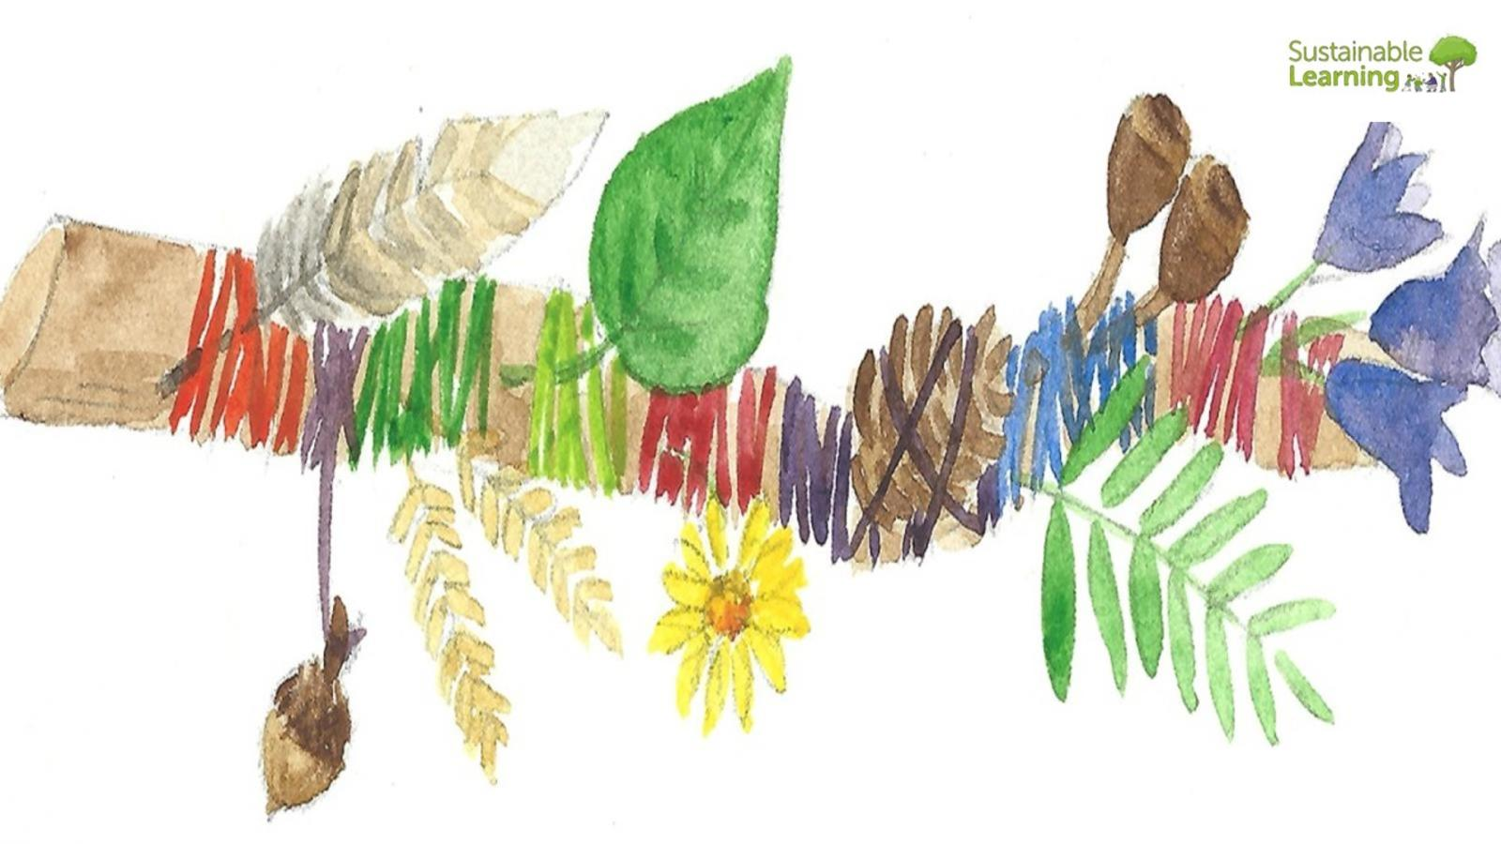
Forest School in Action….a typical session
Journey Sticks
Exploring our local woods
Did you know? Aborigines in Australia and Native Americans are said to have used journey sticks to tell stories about their travels.
This week at forest school we have explored journey sticks. Journey sticks can encourage children to get to know their local woodland and develop a deeper understanding of a journey.
We reminded the children of the countryside code, we discussed how the artefacts they find must be objects they find on the ground rather than picking living plants and all wildlife must
remain in the woods too. We had a special bag to collect any litter we found. All these aspects support the countryside code.
We talked about where our journey started so the children had good understanding of the journey beginning. We searched for artefacts near the start to remind us of that part of the
journey. Some children looked at the big beech tree. We asked the children, “Can we attach the big tree to our sticks”….they laughed!
We decided that we would take rubbings of artefacts that couldn’t be attached. We also used technology to capture images of badger sets, big logs and interesting woodland objects.
When we saw a white van in the woods, we used label tags to have a go at scribing. We sounded out v,a,n then blended to make the word van. Our last encounter in the woods was a very
old beech tree. We used this opportunity to see how many children could hold hands all the way around the tree trunk. We counted together starting at 0 and ending in 20! Our session
ended with a hot chocolate and a snack. We used this quiet time to reflect on the morning in the woods……

Slide 4
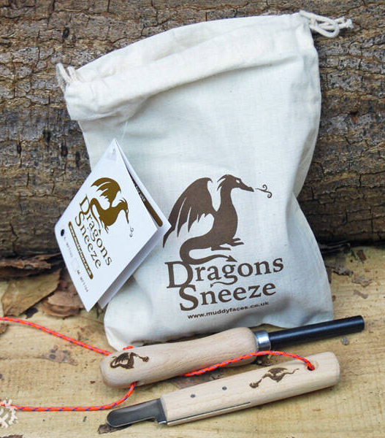
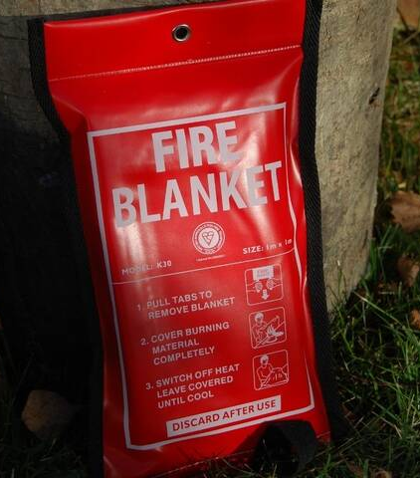
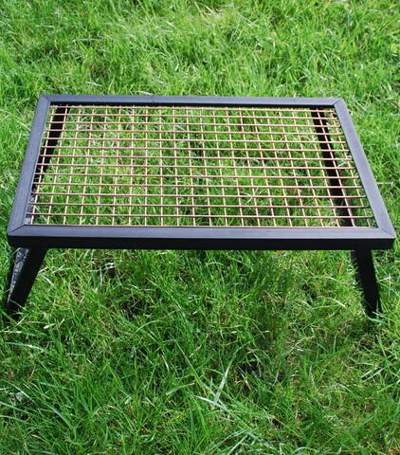
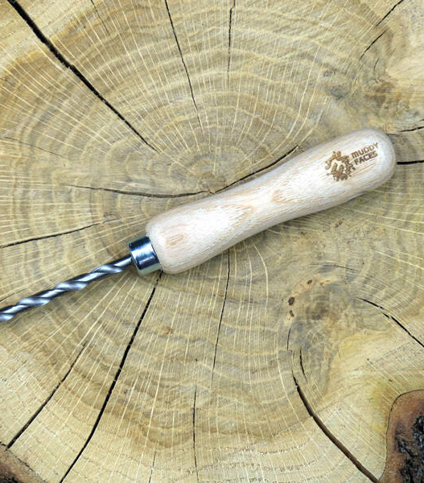
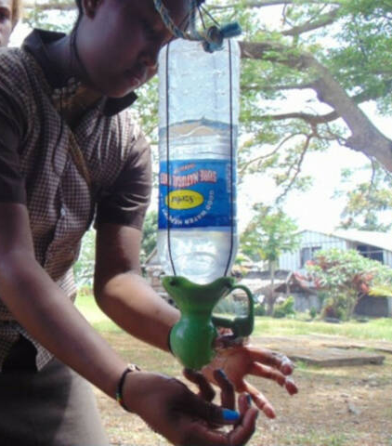
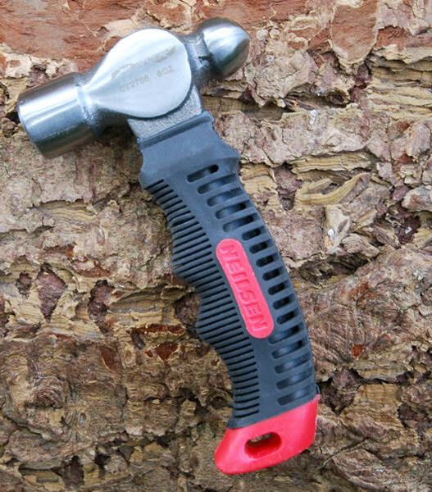
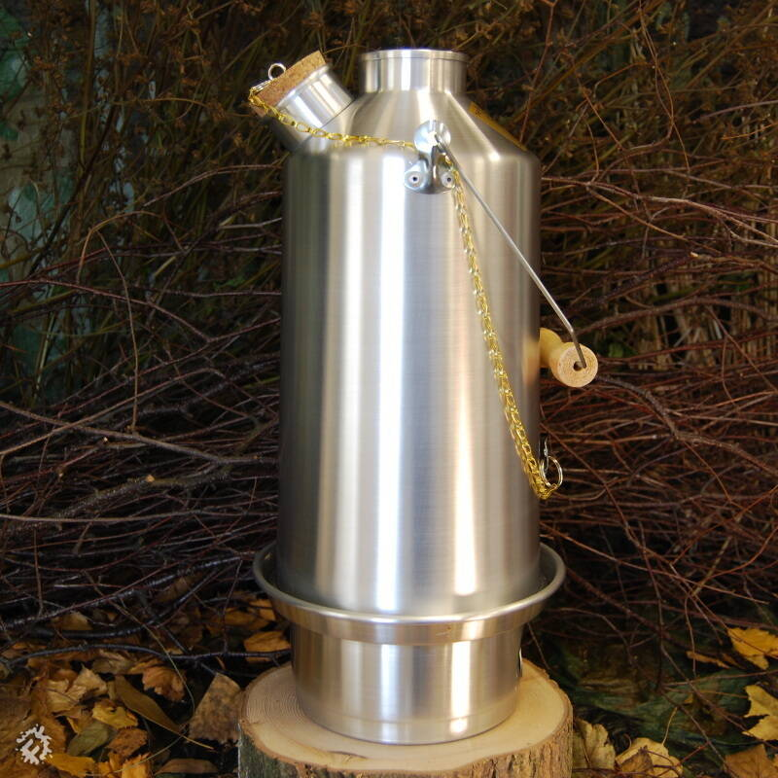
Some of the tools and
equipment that we use during
a typical forest school session.
All tools are used safely and
Are appropriately risk assessed.

Slide 5
Forest School Sessions
My name is Mrs Oldroyd I am part of the foundation team as a HLTA, I am a qualified and experienced forest school leader. I’ve been teaching and leading forest school sessions for about 7 years. Forest school sessions are a wonderful experience for all those who participate. Forest School is a unique approach consisting of regular sessions in our wooded environment throughout the year that will give the children at Elburton an increased contact with, and knowledge of, the natural world. The ethos and process of Forest School enables the holistic personal development of our young learners and benefits their physical and mental wellbeing. We believe that our Forest School sessions help children develop their oracy and communication skills, social relationships and physical confidence.

Slide 6
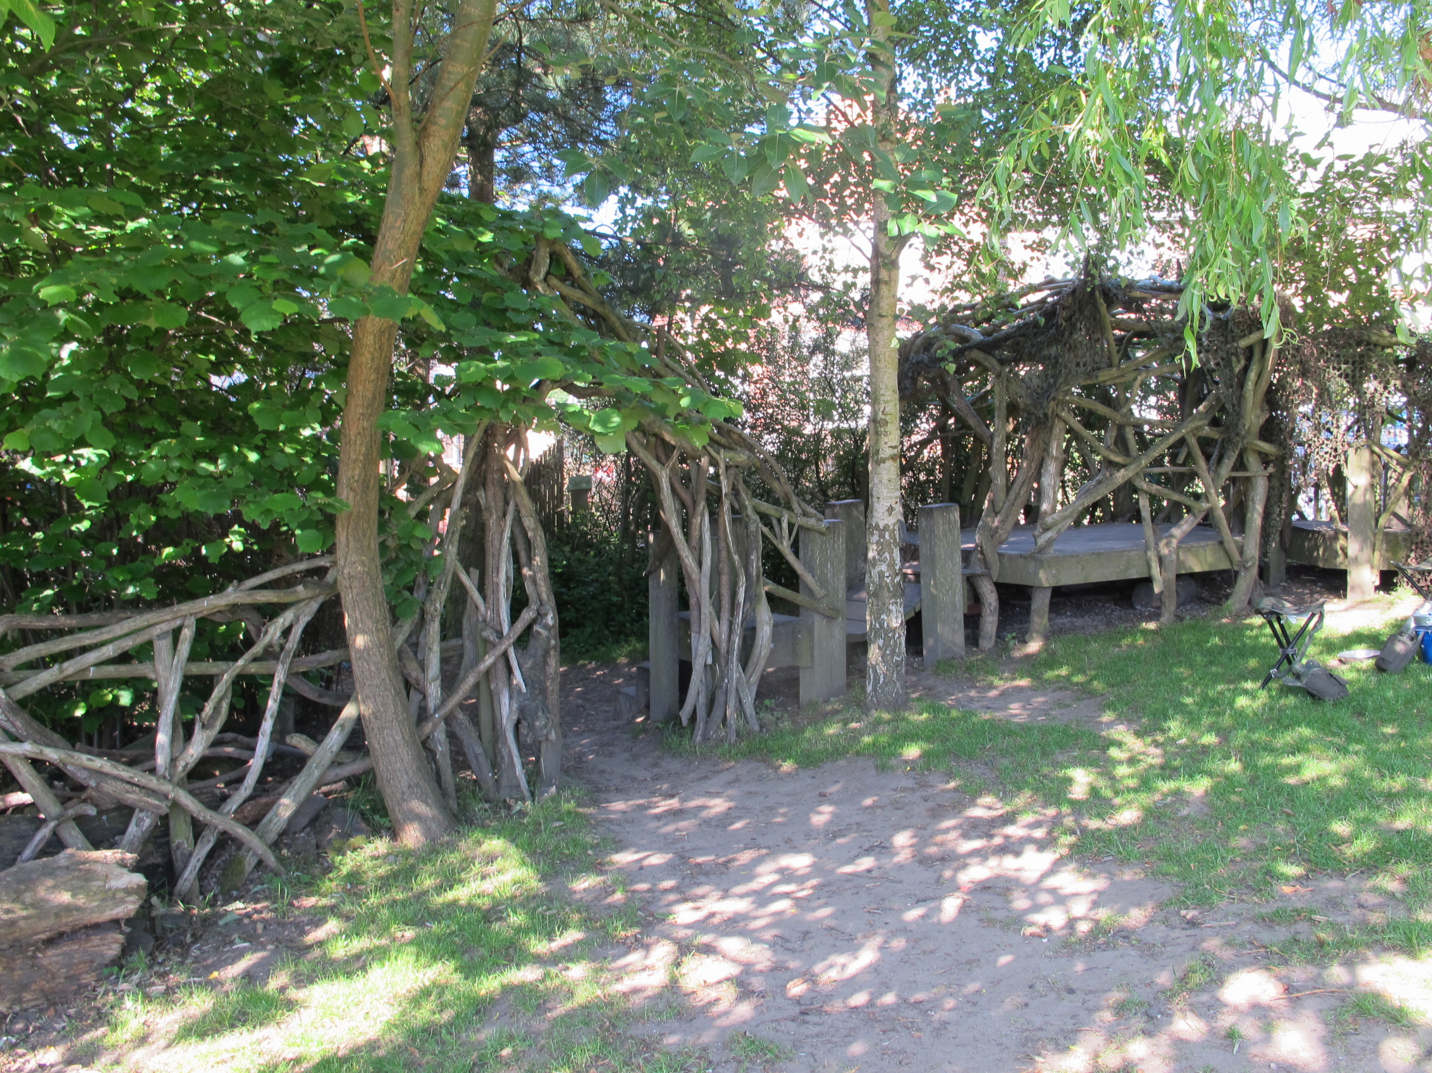
Forest School in all weathers….
We will go out in all weathers, the only exception is high winds
That means clothing must be be correct to help keep every child comfortable
We will always try to make every session enjoyable but weather and poor clothing can affect their enjoyment
If appropriate we will make a fire to keep everyone warm and provide a warm drink of squash, soup or hot chocolate

Slide 7
Kit List Covering all seasons…. WINTER
WHAT TO WEAR IN WINTER
Waterproofs that your child can put on easily or with a little support….practise trying them on.
Base layer - thermals
Next bottom layer - fleece or other warm tracksuit bottoms
First top layer - long sleeve t-shirt or thin jumper
Second top layer - fleece jumper
Third top layer - fleece jacket
Neck scarf
Hat and gloves (please name these as they can be tricky to sort at the end of the day)
Two pairs of socks, one thin pair and one thick warm pair, always pack a spare dry pair in their bookbag. Sticky name labels on socks are a must!
Snow boots or sturdy warm outdoor boots, welly boots are ok for winter, but they must have two pairs of socks on. Trainers are not suitable and can get wet very quickly. Please name all welly boots with initials on the inside or a sticky name label.

Slide 8
Kit List Covering all season’s SPRING/AUTUMN
Waterproofs (please don’t forget to label everything!)
One pair of comfortable trousers (jogging bottoms or leggings)
One long sleeved t-shirt or top
One thick jumper
One fleecy zip up jacket
Two pairs of socks. On the bottom, one thin cotton sock, and the top, a thick wool or fluffy bed sock
Wellies or sturdy closed toe shoes (which you don't mind getting wet and muddy!)
Spare trousers & socks in book bag or left on their peg in a bag that is clearly labelled. All home clothes must be labelled.

Slide 9
Kit List Covering Summer
Waterproofs – (Please label everything!!)
One pair of comfortable trousers (jogging bottoms or leggings)
One t-shirt, light long sleeved t-shirt
One fleecy zip up jacket (just in case it turns chilly or starts raining)
One pair of socks
Wellies or sturdy closed toe shoes (which you don't mind getting wet and muddy!)
A sun hat for sunny days
Spare trousers & socks left at school on their peg
We recommend that children arrive at school already wearing an all-day sunscreen.

Slide 10
When will Forest School take place?

Slide 11
When will forest school take place?
Every Tuesday we plan to run a forest school session onsite at Elburton Primary School.
Ash class will do Forest School in the morning and Aspen in the afternoon session after lunch.
On forest school day your child will come into school in their forest school clothes. This is not an opportunity to wear mufti clothes, so please only wear suitable clothing and check the kit lists if you are unsure.
Typically, your child will come into school in jogging bottoms or leggings, a fleece jumper and a t-shirt. Waterproofs can go in a backpack and be left on their peg. Wear comfortable trainers and bring along welly boots or sturdy walking boots that are named to remain under their peg until its time to go.

Slide 12
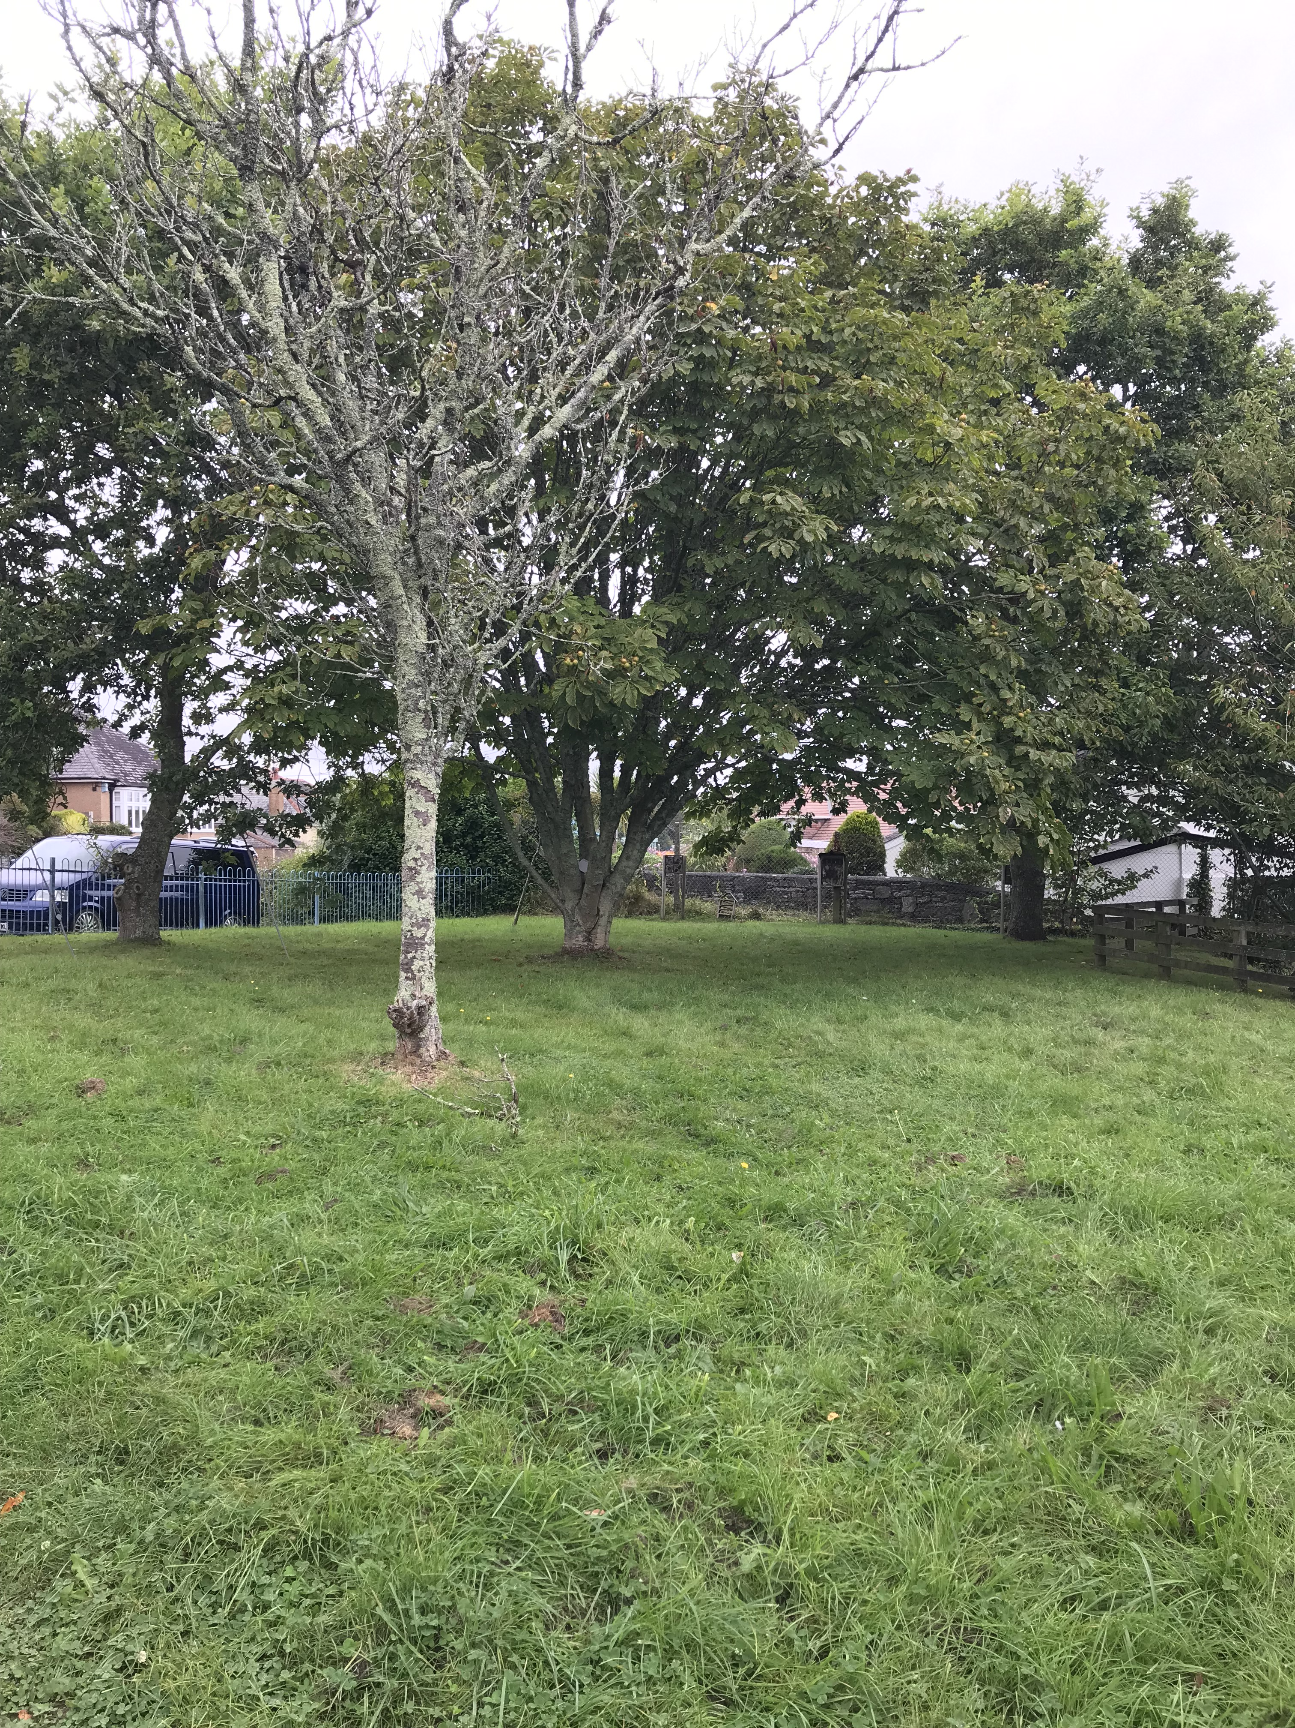
Forest School site at Elburton
At our site we have a mixture of native and non-native trees that will provide a wonderful base for forest school learning.
Safety of the children on the site is paramount and we have thoroughly risk assessed that area to make sure it is safe.
Just like in the woodland environment our children will be on an open area and we have 4 staff to manage the session safely.
The children will quickly learn the boundaries of the site to ensure they engage safely in each session.
If you would like to volunteer to be part of our regular forest school sessions, please speak with Mr’s Churchill.

