Slide 1
Welcome to the ‘Getting To Know Year 4’ Meeting 2019
Inspiring today’s children for tomorrow’s world

Slide 2
The Teaching Team
4SG – Mr Griggs
4SB - Mrs Bates
Teaching Assistants – Mrs Hall
Teaching Assistant Apprentice – Mr Kerridge
SCITT Trainee – Mr Jenkins

Slide 3
Expectations and Daily Organisation
Inspiring today’s children for tomorrow’s world

Slide 4
More emphasis on independence and responsibility (Personal organisation: pencil cases, homework, letters, behaviour etc.).
Importance of water bottles (named and refilled regularly).
Break time snacks (healthy fruit/veg or similar).
PE kits: Everyday to be kept at school.
Towards the end of the year – swimming kit also needs to be in everyday (+ swimming this term on a Tuesday).
Talking partners are changed every 2-3 weeks to ensure children experience a wide range of partners throughout the year.
Inspiring today’s children for tomorrow’s world

Slide 5
HOMEWORK
Homework will be given out on a Friday and needs to be handed in by the following Thursday or before. Please ensure all homework is kept in homework folders.
Reading
10-15 minutes of reading five times a week. Reading to your child is a very powerful learning tool. It provides the opportunity to introduce new vocabulary, model expressive reading, how to read punctuation and you can really concentrate on their comprehension. New reading logs support questioning.
Reading Logs need to be kept up-to-date from reading to them to hearing them read.
Please comment on their reading regularly. Reading aloud has a huge impact on their fluency and understanding of texts and new vocabulary.
Questioning and comprehension is really important.
The Year 4 Reading Army began this week; this is greatly appreciated and will help to support our children’s reading enormously.
Writing
Approximately 30 minutes work
Homework will be based on work that we have covered throughout the week and could take the form of comprehension activities, grammar and punctuation tasks or creative writing.
Inspiring today’s children for tomorrow’s world

Slide 6
Spellings
A discrete spelling lesson takes place every Monday. We also send home a spelling list that is based around this lesson and the children are tested on these words on a Friday.
Maths
Approximately 30 minutes work.
Linked to objectives throughout the week.
Homework to be completed using MyMaths or on sheets.
Times-Tables Rockstars may also be set as there is a big emphasis on times tables in Year 4 – your child has already received their password for this and for MyMaths.
Inspiring today’s children for tomorrow’s world

Slide 7
E-Safety
This is an important issue for children and adults.
There are some documents to support E-Safety on our school website.
If you should have any concerns or feel we should be notified about any inappropriate online content, please don’t hesitate to let us know.
Inspiring today’s children for tomorrow’s world

Slide 8
Assessment
Inspiring today’s children for tomorrow’s world

Slide 9
Assessment
Assessment will take place during lessons and from marking books as before. This information will then be used to support children who do not know or understand something. It will help us to target that support where it is needed.
This will build up to an end of year teacher assessment based on whether children have achieved the Age Related Expectations or not. It will also take account of how well children are able to reason and explain.
We will also be trialling a times tables assessment later in the year.

Slide 10
Mathematics
Inspiring today’s children for tomorrow’s world

Slide 11
Introduction
Objectives based on ARE’s (Age Related Expectations)
We have a ‘confident to be wrong’ approach to maths; it’s important for children to understand that they can learn from their mistakes.
Weekly morning maths (mainly arithmetic)
Times-Tables RockStars
Weekly discrete arithmetic lesson (Fridays)
Deeper thinking activities through investigations and problem solving
Inspiring today’s children for tomorrow’s world

Slide 12
The children use manipulatives and representations to help visualise numbers and mathematical problems.
Inspiring today’s children for tomorrow’s world

Slide 13
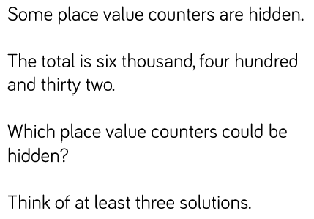
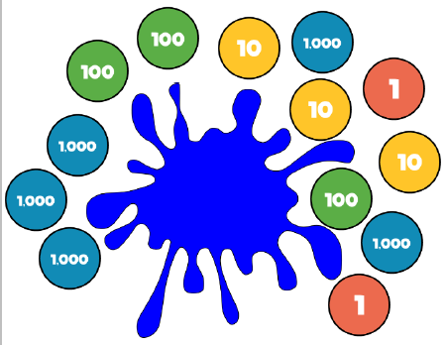
LI: To explore how numbers can be partitioned.
Independent work:
Problem Solving:
1. Look at the representation. Record six different ways of partitioning this number.
2. Josh says, “My number has 4 thousands, 8 hundreds and 27 ones”. What is Josh’s number?
3. Sally says, “My number has 3 thousands, 12 hundreds and 6 ones”. What is Sally’s number?
Inspiring today’s children for tomorrow’s world

Slide 14
Importance of responding in a sentence.
Can anyone tell me what the value of the 8 is in this number?
The digit 8 is in the hundreds column therefore I know
that the 8 represents 800.
Inspiring today’s children for tomorrow’s world

Slide 15
STEM sentences
Inspiring today’s children for tomorrow’s world

Slide 16
English
Inspiring today’s children for tomorrow’s world

Slide 17
Writing
Through the year, we will cover a range of genres.
Focus on pride in all written work throughout all subjects.
Children will be involved in both self and peer assessment to help them improve their writing.
Throughout the year children will have lots of opportunities to draft and edit longer pieces of writing.
This year it has been decided by the teaching team that in Year 4 all children will be writing in pencil.
Non-negotiables for writing will include capital letter, full stops and joined, cursive handwriting.
Inspiring today’s children for tomorrow’s world

Slide 18
Reading
Reading at home: 10-15 minutes five times a week.
Guided Reading. We teach this through various different methods. We like to combine whole class reading with smaller group reading.
There are also plenty of opportunities for children to read independently throughout the week.
We also have a class reader which is read throughout the week.
Book challenge. The children are encouraged to read different authors and genres to try and extend their reading. Exposure to this is very important.
Inspiring today’s children for tomorrow’s world

Slide 19
Reading
There is a big emphasis on reading this year in order to raise the profile of reading throughout the school.
We have several new initiatives to enhance the children’s love of reading and to enrich their vocabulary.
Word of the Day
ERIC – Explain, Retrieve,
Interpret & Choice.
Developing higher order
reading skills such as inference.
Class reader – allowing all
children to access texts for
pleasure and to extend their
vocabulary, ideas and inform
their own writing.
Inspiring today’s children for tomorrow’s world

Slide 20
Speaking and Listening
In school we ask the children to:
Speak to different audiences (drama, role play, performance poetry, debate).
Use appropriate vocabulary for different audiences. Encourage them by modelling high level vocabulary.
The biggest difference you can make for your child is to:
Insist your child talks in full sentences.
Not use ‘Yeah’, ‘fine’ or ‘K’ (don’t let them overuse this).
Insist they show good listening habits such as stopping, looking you in the eye and repeat instructions.
Inspiring today’s children for tomorrow’s world

Slide 21
How to Help
Continue to listen and read to your child regularly
Be involved in homework (but don’t do it for them!)
Help your child learn their addition and multiplication facts
Promote a positive attitude to learning - please don’t share negative school experiences. Ask them carefully crafted questions not just how was your day? Promote positivity!
Insist on the basics in writing and in speech at all times (GHaSP)
Inspiring today’s children for tomorrow’s world

Slide 22
Thank you for attending tonight; we hope it has been useful.
If there are any general questions, please feel free to ask us after the session. However, if it relates specifically to your child, please feel free to organise a set time with us at another time.
We look forward to seeing you at forthcoming parents’ evenings.
Once again, a massive ‘Thank You’ to our wonderful READING ARMY!
Inspiring today’s children for tomorrow’s world

